Slide 1

I
Zine Workshop:
NC Heroes

Slide 2
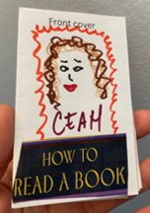
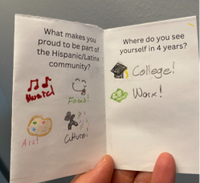
What are Zines?
Zines are self-published, DIY publications.
They are often produced in small runs and distributed within communities and groups.​
Historically, zines have been used to explore themes related to culture, history, self-expression and community.

Slide 3
Zine Activity Prompt:
NC Heroes
Who are the heroes of North Carolina—past or present—who inspire you? Create a zine page that celebrates their story, impact, or legacy through words, drawings, or collages.

Slide 4
Zine-Making Instructions
Brainstorm
  Start brainstorming or outlining ideas for your zine using the digital resources provided.
Zine Creation
  Fold: For this activity, use the zine template provided to fold and cut the zine. More instructions are available on the zine printout at each table.
  Use the "cut and paste" method: cut out text and images and paste them onto your zine in your chosen layout.
  Include a mix of images and short descriptions, phrases, or captions.
  Think about visual elements and phrases that convey your ideas.

Slide 5
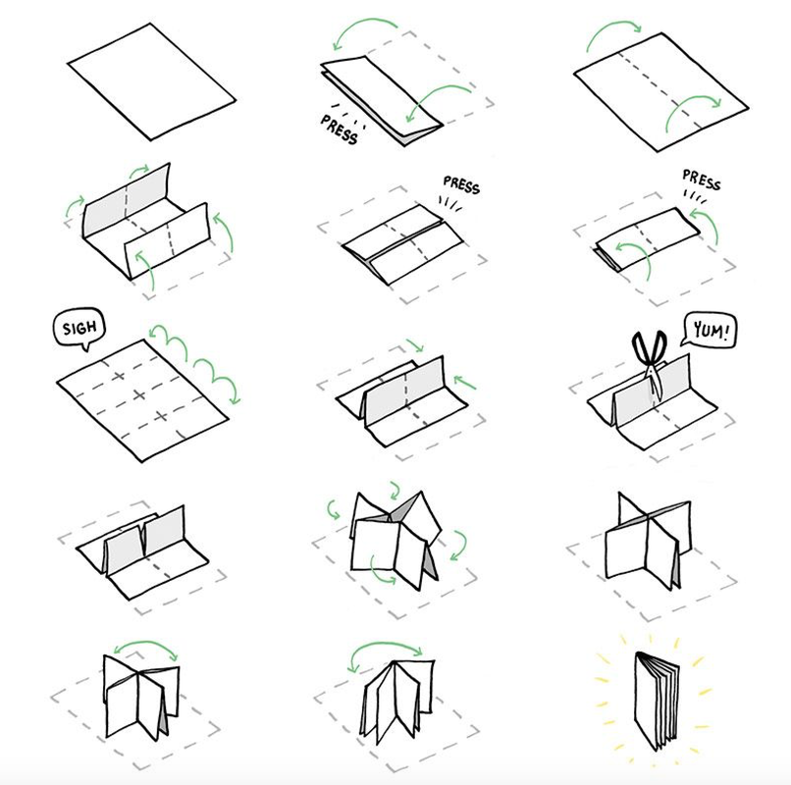
How to Fold a Zine
Take a letter-sized paper (8.5" x 11")
Fold paper in half vertically (long ways)
Fold paper in half horizontally
Unfold to reveal 8 sections
Fold paper in half with short sides together
Cut a small slit in the center fold
Unfold and squish the paper together, using the slit to help create pages
Press creases firmly to make the zine sit flat

Slide 6
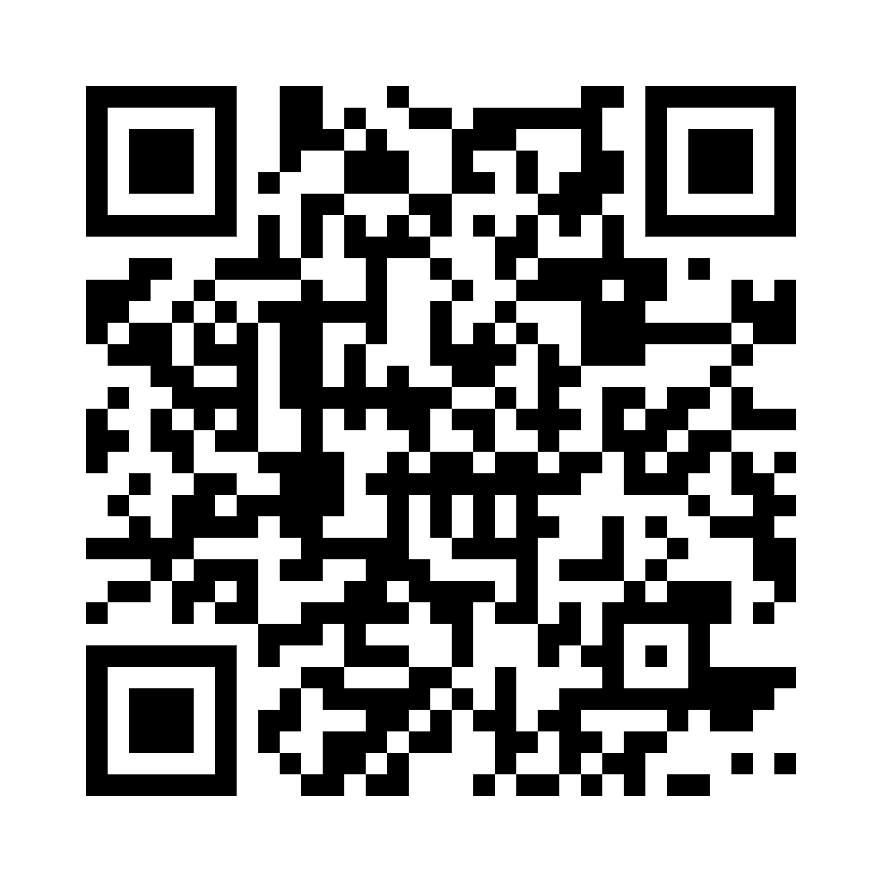
Zine-Prompts and Resources
Potential Page Prompts:
Portraits
Quotations
Stories
Inspirations and Motivations
Impact and Legacy
Illustrations
Collages
Poems
Timelines
Scan this code to access our online resource guide and get started researching local and family histories!

Slide 7
Give us feedback on this event!
SLNC.info/GHLEvents
7

